Slide 1

Mental Health eScreening Healthcare System Technical Administrator Training

Slide 2
Welcome to MHE!
Mental Health eScreening (MHE) tablets present mental health assessments to newly registering OEF/OIF/OND Veterans who are willing to begin their initial data entry while still in the VA waiting room. The tablets capture Veterans’ data securely and confidentially.
Meanwhile, MHE provides a dashboard for clinicians to view the ongoing assessments, which tracks Veterans’ progress overall, and highlights those Veterans who need assistance to complete their assessments.
The MHE dashboard shows a real-time alert for any responses that exceed warning parameters, such as suicide indicators. This allows clinicians to single out and fast-track Veterans who may be undergoing a crisis but not displaying the outward signs of it.

Slide 3
MHE Research Pilot
For the last 2 years, the Center for Excellence in Stress and Mental Health (CESAMH) has been using eScreening for OEF/OIF/OND Veterans enrolling in VA Health Care in San Diego.
About half of the newly enrolled had risk factors for suicide, indicating the need for immediate clinical follow-up. Many Veterans had symptoms of depression and anxiety, and the majority were in physical pain.

Slide 4
Findings from the research pilot
MHE tablet-using Veterans had their screenings documented an average of 19 days sooner than the Veterans who used paper forms.
Almost all of the tablet-using Veterans who wanted help were able to speak with a clinician within 3 days, versus 2-3 months with the old system of paper forms.
MHE was preferred by both Clinicians and Veterans.

Slide 5
Conclusions
Clinical Care Improvements
timely triage to appropriate services (approximately 40% of Veterans need immediate follow-up with the Suicide Risk Assessment)
the ability to monitor treatment outcomes over time
increased encouragement of Veterans with immediate personalized feedback
greater overall Veterans’ satisfaction due to an increase in trust
Administrative Benefits
increased screening capacity (improved VA-mandated screening rates)
improved capability to monitor ongoing treatment outcomes (efficiency)
Reduced time needed for clinical care and documentation (cost savings), and
increased quality of care without increasing staff (cost savings).

Slide 6
MHE training notes
Notes that relate to the topic will appear under some slides.
Notes:
The notes will be here.

Slide 7
MHE Healthcare System Technical Administrator (HSTA) training
System overview
HSTA tasks and permissions
Managing your users
Customizing MHE for your site
Editing forms and templates
Correcting assessments in an error state
Troubleshooting
Getting help
Notes:
A self-review follows each topic.

Slide 8
MHE system overview
The eScreening system consists of three principal components, all based on open-source web technology:
A forms editor for designing assessments and note templates,
A Veteran assessment portal that Veterans will access on VA clinics’ Samsung and Apple tablets, and
A web-based administrative dashboard (staff portal) that allows clinicians to monitor assessment progress, view assessment alerts, review completed assessments, and publish generated reports to VistA and CPRS. The dashboard also handles exporting of assessment data for data analysis.

Slide 9
MHE system overview
Both the dashboard and the forms editor are under the same staff portal, but HSTAs are the only ones who have access to the forms editor. The staff portal runs inside of the VA on a tablet or laptop computer web browser.
The Veteran portal requires wireless access for tablets. All communications between the tablets and the eScreening server are securely encrypted, and no Veteran data is stored on the tablets running the assessments. Tablets are VA property and do not function outside of hospital grounds.
The eScreening server will operate from the San Diego data center and will be protected by VA security and firewalls. All listed components are behind the VA firewall. Outreach can only take place through a secure VA VPN connection.

Slide 10
MHE system overview Self-Review question
MHE has a forms editor for HSTAs, a dashboard for clinicians, and a …
Veteran portal accessible from any personal computer.
downloadable application for Veterans’ Samsung and Apple tablets.
Veteran portal that works on Samsung and Apple tablets on VA property only.
secure VA firewall (MHE has no Veteran portal).

Slide 11
MHE system overview Self-Review answer
MHE has a forms editor for HSTAs, a dashboard for clinicians, and a …
Veteran portal accessible from any personal computer.
downloadable application for Veterans’ Samsung and Apple tablets.
Veteran portal that works on Samsung and Apple tablets on VA property only.
secure VA firewall (MHE has no Veteran portal).

Slide 12
MHE system overview Self-Review question
MHE’s clinician dashboard allows clinicians to …
monitor assessment progress and view alerts.
review completed assessments.
publish generated reports to VistA and CPRS.
All above statements are true.

Slide 13
MHE system overview Self-Review answer
MHE’s clinician dashboard allows clinicians to …
monitor assessment progress and view alerts.
review completed assessments.
publish generated reports to VistA and CPRS.
All above statements are true.

Slide 14
MHE HSTA training
System overview
HSTA tasks and permissions
Managing your users
Customizing MHE for your site
Editing forms and templates
Correcting assessments in an error state
Troubleshooting
Getting help

Slide 15
HSTA tasks & permissions
With junior system administrator powers plus all the permissions that clinicians have, the HSTA role is critical to the smooth functioning of MHE. Tasks:
Customize the interface to reflect your site
Create initial clinician and assistant users & edit for user changes as needed by staff (Managing your users)
Create & edit templates to comply with updates to VA clinical mandates
Correct assessments that are in an error state so that clinicians may proceed
Helpdesk-style assistance for clinicians and assistants with MHE-related issues, and minor system troubleshooting
Create, edit, and upload assessments in the event of a clinician shortage (see MHE User Training Guide for Clinicians and Assistants)
Notes:
We will review each of these tasks, beginning with a word about creating assessments in the event of a clinician shortage.

Slide 16
HSTA tasks Creating assessments from the Clinician role
Although both HSTAs and Clinicians “create assessments”, the task is different.
HSTAs can use the New Battery button on the Editors’ page to build a basic assessment (also called a “battery”) from its module components.
Clinicians do not have access to editors. Clinicians use their Create Battery tab to associate particular assessments (which are either pre-built and provided with the software, or built by the HSTA using editors), in the system with specific Veterans. Clinicians have some leeway within their procedure to add, or subtract modules from their pre-packaged assessments.

Slide 17
HSTA tasks Creating assessments from the Clinician role
The system is configured so that an assessment must be linked to a given Veteran before that Veteran can log in. After a clinician or assistant has associated one or more assessments with a Veteran, MHE will allow that Veteran to log in from a tablet and navigate through the assessment(s).
As an HSTA, you may be asked “create assessments” from the clinician role. Using your Create Battery tab, you can “create” (associate) an assessment for a Veteran’s unscheduled visit, or you can “create” (associate) assessments by the batch for the next day’s appointments.
Consult the User Training Guide for Clinicians and Assistants for both procedures.

Slide 18
HSTA tasks Self-Review question
Regarding HSTA tasks and permissions:
HSTAs have all the permissions that clinicians do, plus some system privileges.
HSTAs are expected to teach clinicians how to perform Internet searches on health topics related to Veterans’ needs.
HSTAs can only create assessments from the Editors tab.
1 and 2 are true.

Slide 19
HSTA tasks Self-Review answer
Regarding HSTA tasks and permissions:
HSTAs have all the permissions that clinicians do, plus some system privileges.
HSTAs are expected to teach clinicians how to perform Internet searches on health topics related to Veterans’ needs.
HSTAs can only create assessments from the Editors tab.
1 and 2 are true.

Slide 20
MHE HSTA training
System overview
HSTA tasks and permissions
Managing your users
Customizing MHE for your site
Editing forms and templates
Correcting assessments in an error state
Troubleshooting
Getting help

Slide 21
Managing your users Create initial clinician & assistant users
After you receive access to MHE, create your site’s staff users.
Before starting this task, you must:
have a list of users and their system roles, first and last names, phone numbers, and email addresses, and
be prepared to create a user ID and a password for each one.
After creating the system users:
provide the users with their user IDs and passwords, and
instruct them to change their passwords after logging in.

Slide 22
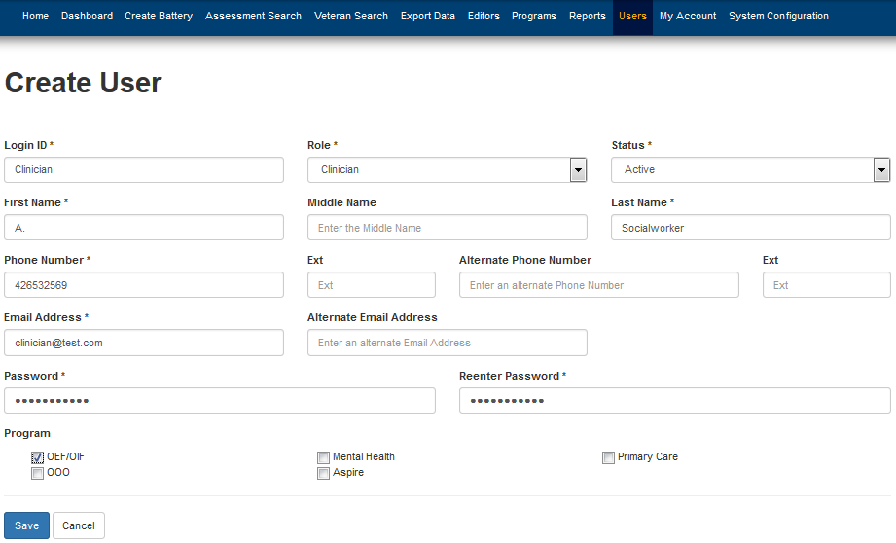
Managing your users Create initial clinician & assistant users
Notes:
1. From the User Management page on the User tab, click Create New User.
The Create User page opens.
2. Type the user’s data in the appropriate fields.
IMPORTANT! Be sure to select the check box for the program.
3. Click Save.

Slide 23
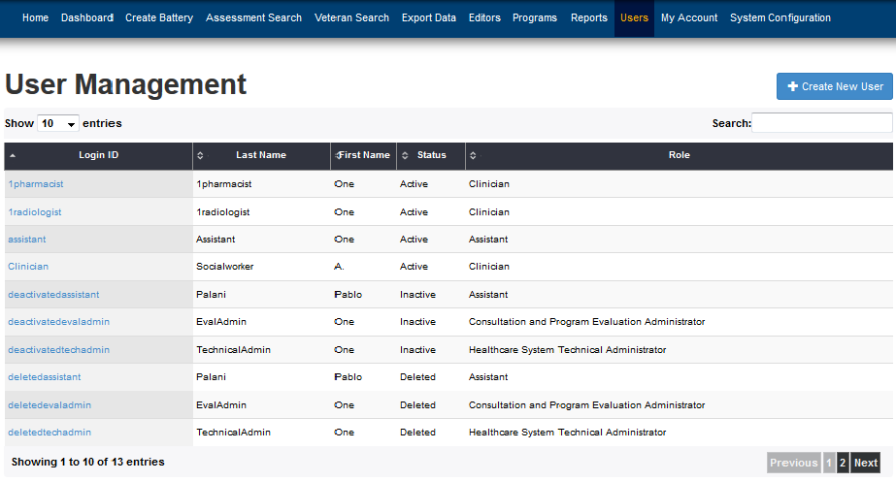
Managing your users Create initial clinician & assistant users
You are returned to the User Management page, and the new user is listed there.
Notes:
Remember,
after creating your site’s system users:
provide the users with their user IDs and passwords, and
instruct them to change their passwords after logging in the first time.

Slide 24
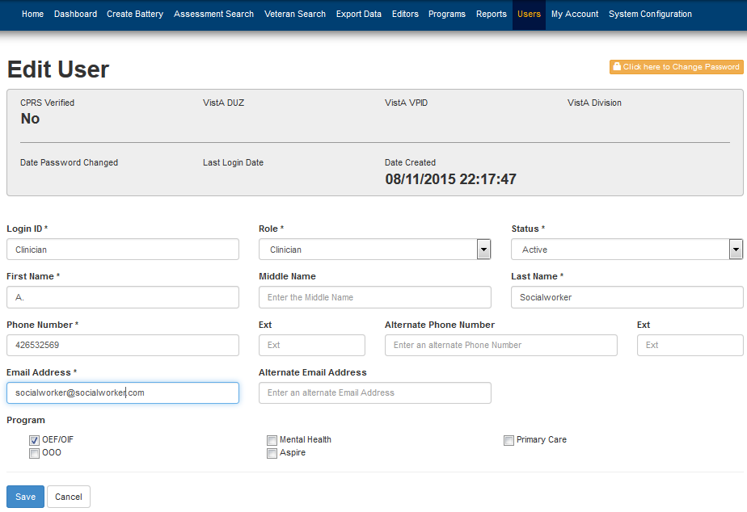
Managing your users Edit for user changes
Update user data by clicking the user’s ID to open the Edit User page,
then make changes to the data, then click Save.
Notes:
In this example, the email address is being updated.
After clicking Save, you are returned to the User Management page.

Slide 25
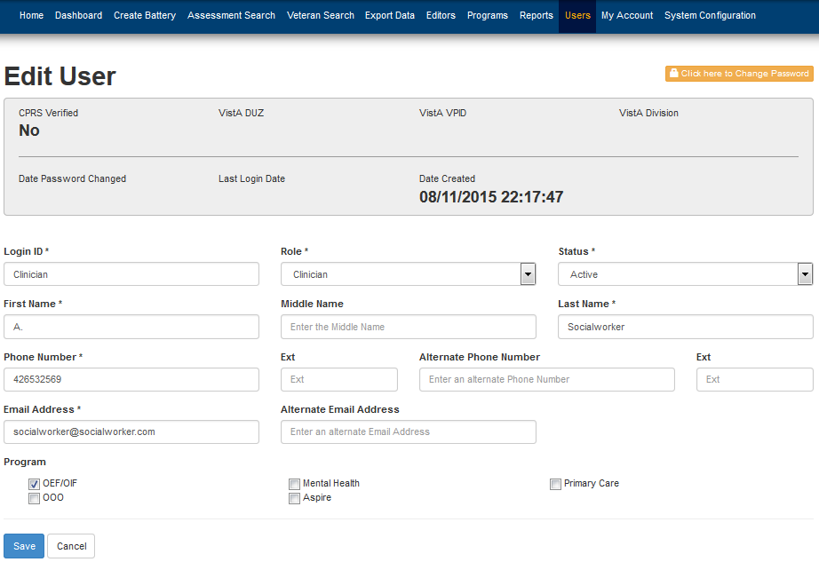
Managing your users User passwords
When users forget their passwords, you cannot retrieve their old passwords, however, you can reset their accounts to new passwords.
1. Click the user’s name on your User Management page.
The Edit User page opens for that user.
2. Click Click here to Change Password.
A pop-up window allows you to type and save a new password.
Notes:
Remember to remind the user to change the password you have provided.

Slide 26
Managing your users Self-Review question
Regarding lost staff passwords, HSTAs …
should refer staff to VA IT for a new account and password.
cannot recover lost passwords, but can provide a new password.
can recover lost passwords and request staff to change them.
do not manage passwords.

Slide 27
Managing your users Self-Review answer
Regarding lost staff passwords, HSTAs …
should refer staff to VA IT for a new account and password.
cannot recover lost passwords, but can provide a new password.
can recover lost passwords and request staff to change them.
do not manage passwords.

Slide 28
Managing your users Self-Review question
Managing your users consists of …
creating staff log-in IDs and passwords initially.
editing a user’s name or phone number if it changes.
creating new passwords for users who have forgotten theirs.
All of the above.

Slide 29
Managing your users Self-Review answer
Managing your users consists of …
creating staff log-in IDs and passwords initially.
editing a user’s name or phone number if it changes.
creating new passwords for users who have forgotten theirs.
All of the above.

Slide 30
MHE HSTA training
System overview
HSTA tasks and permissions
Managing your users
Customizing MHE for your site
Editing forms and templates
Correcting assessments in an error state
Troubleshooting
Getting help

Slide 31
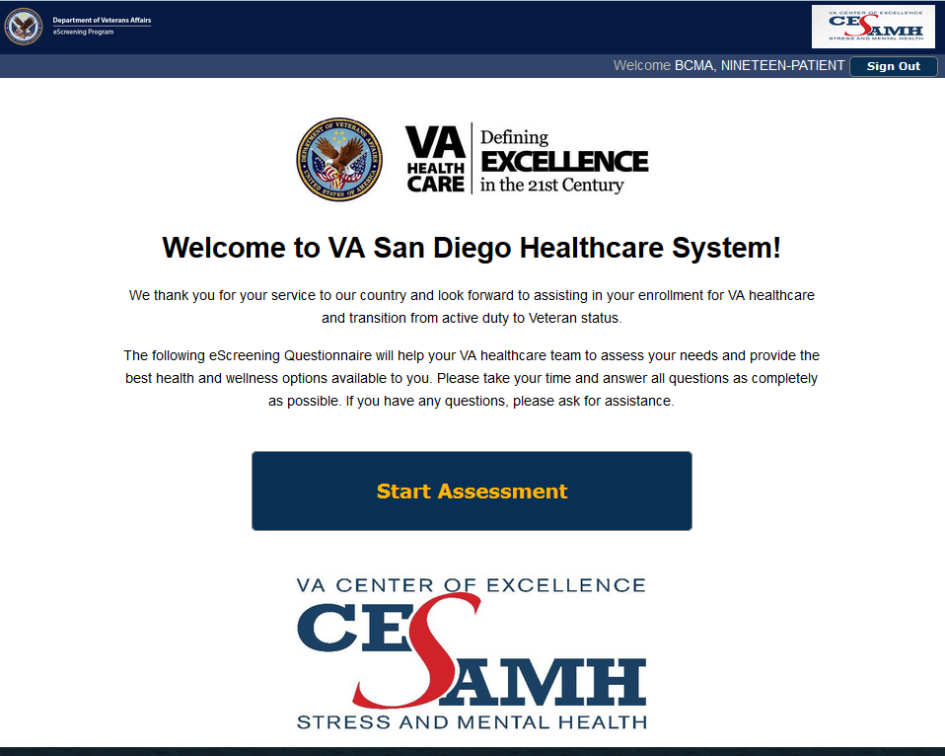
Customizing MHE for your site Customizing initial templates
MHE contains stock templates, parts of which can be customized for your site. Here is a typical customization explained in a 9-step procedure.
The Assessment Welcome page is shown to Veterans at the start of an assessment. You can personalize this template to reflect a welcome from your location.
There are other templates you can personalize using this procedure, such as the Assessment Conclusion Text, which appears when a Veteran has completed a battery. This template is shown after the procedure.
Notes:
Refer to the HSTA Administrator Training Manual for a list of template types, their locations, descriptions, and whether to edit them through the Battery Editor or the Module Editor.

Slide 32

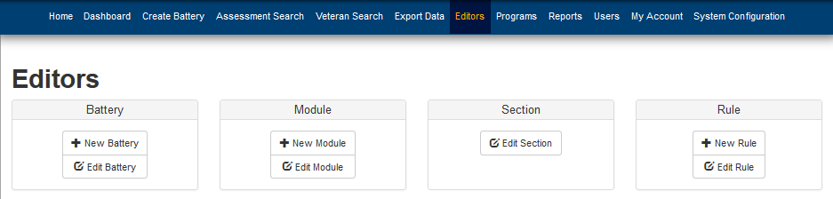
Customizing MHE for your site Customizing initial templates
1. From your Home page, click the Editors tab.
The Editors page opens.

Slide 33
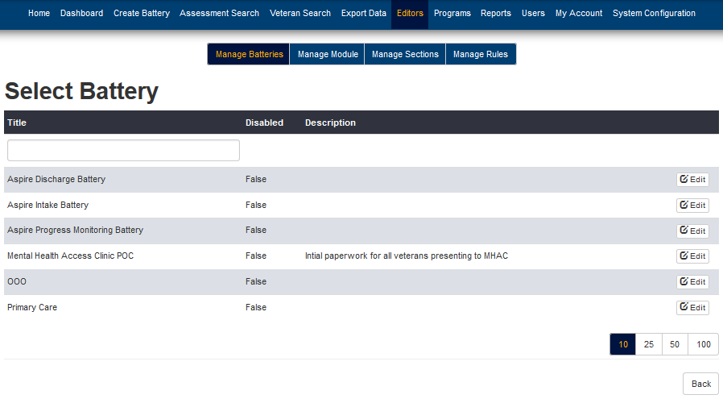
Customizing MHE for your site Customizing initial templates
2. Click Edit Battery.
The Select Battery page opens.
3. Click the Edit button in your program’s row.

Slide 34
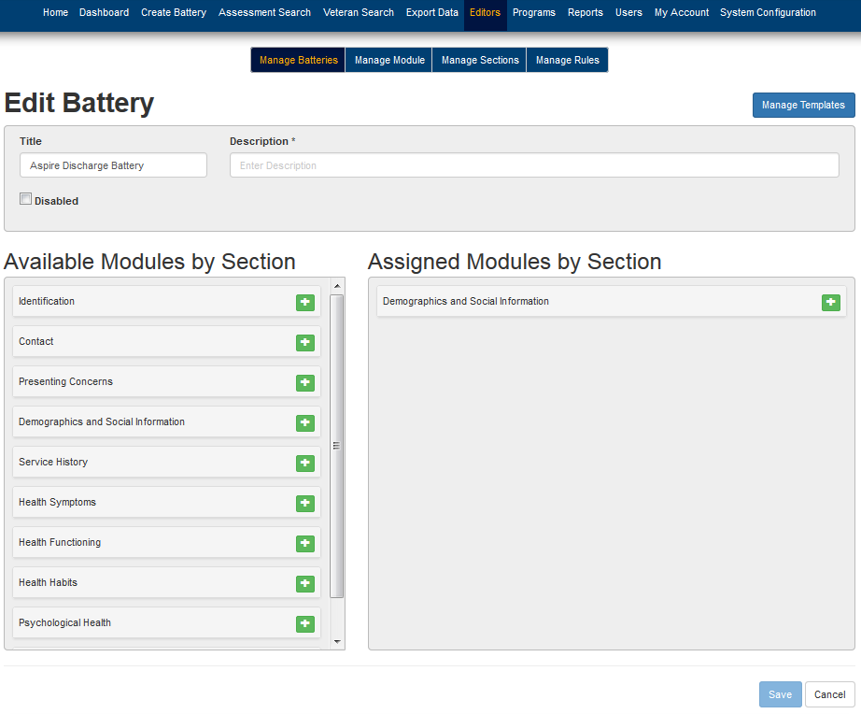
Customizing MHE for your site Customizing initial templates
The Edit Battery page opens.
4. Click Manage Templates.

Slide 35
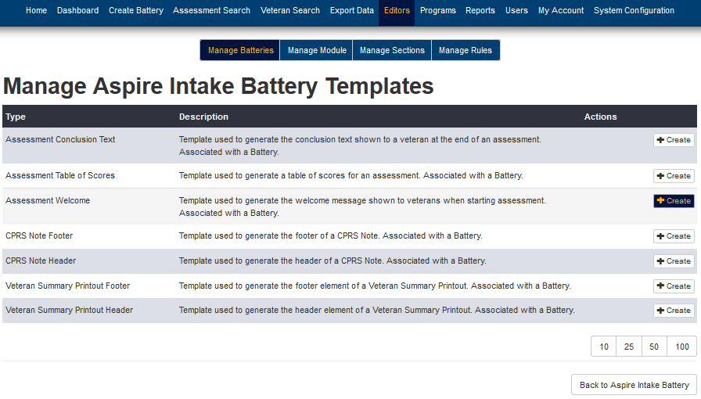
Customizing MHE for your site Customizing initial templates
A Manage Templates page opens.
5. Click Create in the Assessment Welcome row.

Slide 36
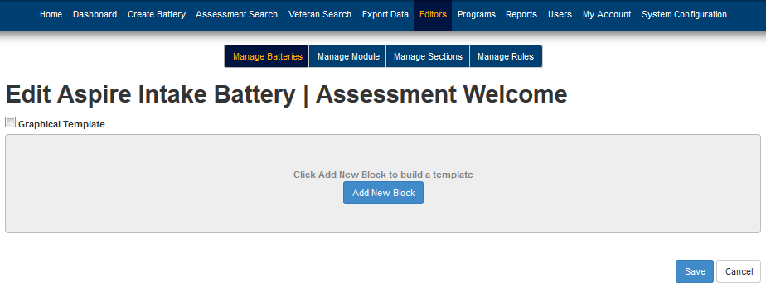
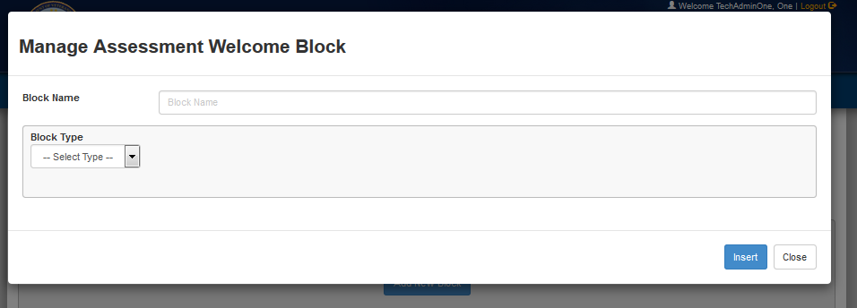
Customizing MHE for your site Customizing initial templates
The Assessment Welcome template opens.
6. Click Add New Block.
The Manage Assessment Welcome Block pop-up window opens.
7. Type a name for the Block name, then select Text from the Block Type drop-down list.
Notes:
Block types are:
If
Text
Table

Slide 37
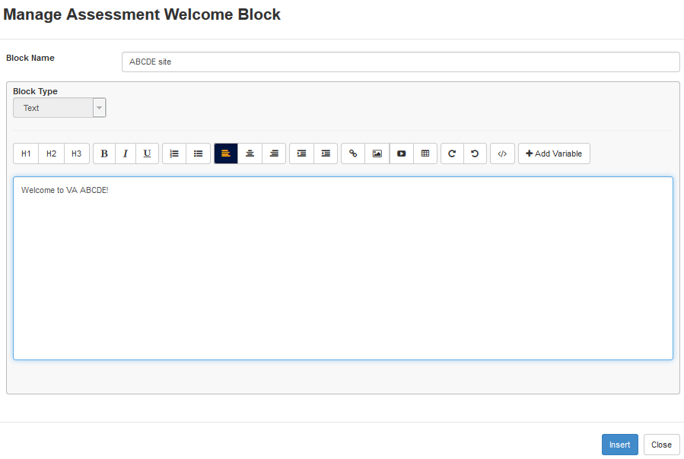
Customizing MHE for your site Customizing initial templates
An input screen opens.
8. Type the new Welcome text, then click Insert.

Slide 38
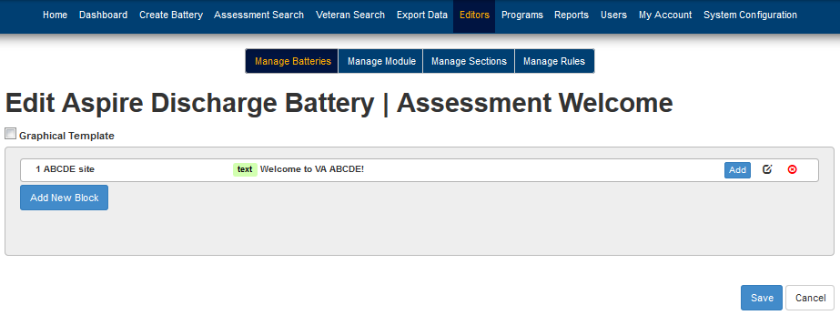
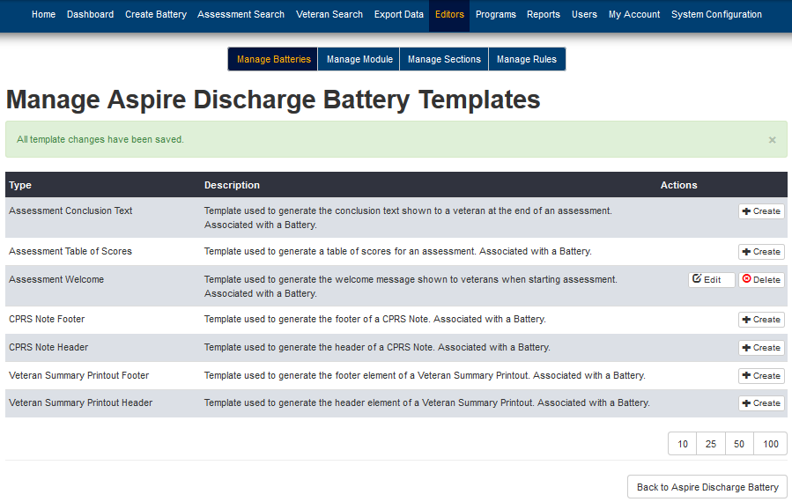
Customizing MHE for your site Customizing initial templates
9. Click Save.
You are returned to the Manage Templates page. A banner tells you the changes are saved, and an Edit button appears in the Assessment Welcome row for your convenience with any future amendments.

Slide 39
Customizing MHE for your site Customizing initial templates
Your new Welcome message appears when the Veteran logs in.
Welcome to VA ABCDE!

Slide 40
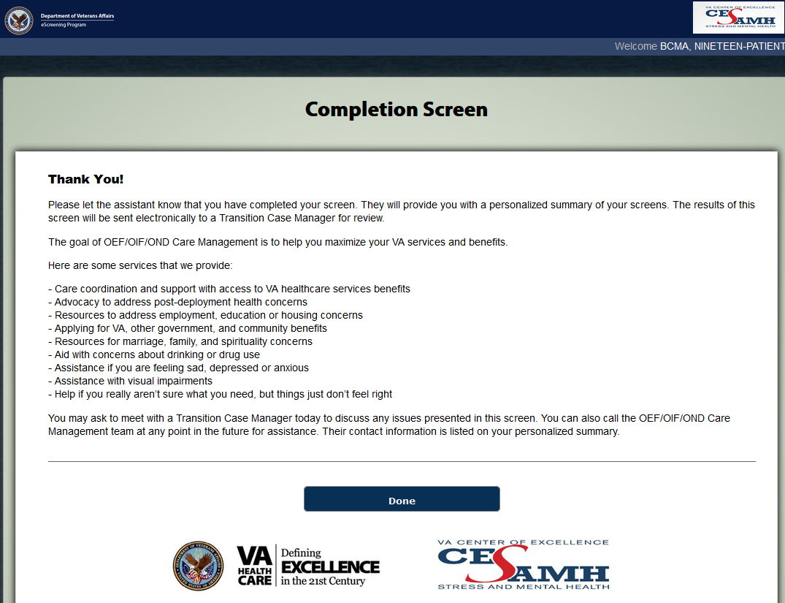
Customizing MHE for your site Customizing initial templates
Another template that you can customize using the above procedure is the Veteran’s completion screen, which appears when a Veteran completes an assessment.
Notes:
Consult the Administrator Training Manual for details regarding template types you may customize for your site.

Slide 41
Customizing MHE for your site
When your clinic converts to using MHE, you will be provided with the latest software release. It will contain pre-grouped batteries, modules, rules, formulas, and sections.
It may not be necessary to make changes to any of these components initially. MHE contains forms editors in case changes are necessary to meet VA compliance. For example, the VA mental health community may decide that a new question should be added to a questionnaire.
If editing changes are necessary, consult the HSTA Administrative Training Manual for explanations and procedures.

Slide 42
Customizing MHE for your site
The forms editors are found in the Editors’ tab.
Notes:
Refer to the Administrator Training Manual for guidance in using the editors.

Slide 43
Customizing MHE for your site Self-Review question
When a site converts to MHE, the HSTA helps pave the way by …
using the Battery tab if changes to batteries or modules are needed.
customizing the Staff Welcome page that Veterans will see when they log in.
customizing the Assessment Welcome page that Veterans will see when they log in.
All of the above.

Slide 44
Customizing MHE for your site Self-Review answer
When a site converts to MHE, the HSTA helps pave the way by …
using the Battery tab if changes to batteries or modules are needed.
customizing the Staff Welcome page that Veterans will see when they log in.
customizing the Assessment Welcome page that Veterans will see when they log in.
All of the above.

Slide 45
Customizing MHE for your site Self-Review questions
Forms editors for editing batteries, modules, sections, and rules, are found in the Editors’ tab on the HSTA Home Page. … True or False?
MHE comes loaded with the most recent software so that HSTAs don’t usually have to make immediate edits for meeting VA compliance, although they may customize templates to reflect their site’s location and intent. … True or False?

Slide 46
Customizing MHE for your site Self-Review answers
Forms editors for editing batteries, modules, sections, and rules, are found in the Editors’ tab on the HSTA Home Page. … True
MHE comes loaded with the most recent software so that HSTAs don’t usually have to make immediate edits for meeting VA compliance, although they may customize templates to reflect their site’s location and intent. … True

Slide 47
MHE HSTA training
System overview
HSTA tasks and permissions
Managing your users
Customizing MHE for your site
Editing forms and templates
Correcting assessments in an error state
Troubleshooting
Getting help

Slide 48
Editing forms and templates to comply with changing VA clinical mandates
Because clinics vary in the paper forms that they use, MHE was designed to allow customization of the software right down to the questions used in the assessments, the note titles, and much more.
The forms editors, located on the Editors tab, consist of several editors used to customize MHE to a given clinical workflow. The editors at your disposal are: battery editor, module editor, section editor, rules editor, formula editor, and template editor. Each of these provide the flexibility to tailor MHE to your clinic's needs, and the needs of the VA mental health community.

Slide 49
Editing forms and templates to comply with changing VA clinical mandates
For example, HSTAs can:
access the list of defined modules (sets of questions),
select a module for editing, and
add new questions as directed.
HSTAs can also update any components or business rules to reflect the addition of questions. A business rule can be created or updated if the response to the added question affects which question or questions the Veteran sees next.

Slide 50
Editing forms and templates Components
Here is an overview of components that can be edited from the Editors tab.
Questions and Answers
The smallest units in eScreening are questions and answers.
Question 3
Question 1
Answer Q Answer R
Answer S
Answer T
Question 2
Answer A Answer B
Answer C
Answer A Answer Q
Answer X
Answer Y
Answer Z

Slide 51
Editing forms and templates Components
Templates
Templates are used throughout the system. Templates provide a way of customizing:
text that is presented to the Veteran before and after an assessment.
reports that are given to the Veteran after an assessment.
a progress note submitted to VistA.
a clinician's assessment summary.

Slide 52
Editing forms and templates Components
Templates, continued
Templates are made up of blocks. When a template is rendered, these blocks are used to produce the final text output of the template (for example, a progress note).
Blocks can be of type: condition, text, or table.
The blocks contained in a template are organized as a hierarchy. This means that a block can have zero or more child blocks associated with it.
The template editor allows the HSTA to create and delete templates. There is an entry point for the template editor from both the Battery editor and the Module editor, because some templates are associated with batteries, and others with modules.

Slide 53
Editing forms and templates Components
Module
Modules
A module is a customized container of questions. Modules correspond to questionnaires.
Most modules are self-evident, such as the Basic Demographics Module. Some modules are in the form of clinical reminders, such as the Homelessness Clinical Reminder Module.
Question 1
Answers
Question 2
Answers

Slide 54
Editing forms and templates Components
Module A
Modules and their templates
In addition to questions, each module contains 4 templates that apply to that module, wherever it occurs in the system.
The templates are:
CPRS Note Entry
Veteran Summary Printout
Veteran Progress History
VistA Q & A
For example, any time the PC-PTSD module is used, the PC-PTSD CPRS Note Entry template will be available with it.
Question 1
Answers
Question 2
Answers
Module A Templates
Templates
i
ii
iii
iv

Slide 55
Editing forms and templates Components
Modules, continued
From the Editors’ tab, click the Edit Module button to reach the module editor page, where you can create new modules or view a list of existing modules. You can also create, update, re-order, or delete questions.
The module editor page also contains navigation buttons for the formula and template editors.

Slide 56
Editing forms and templates Components
B a t t e r y
Module C
Module A
Batteries, AKA Assessments
A battery is a collection of specific modules.
The battery editor allows the HSTA to create new batteries or edit existing ones. Each battery can have modules added or removed.
Batteries are sometimes called Assessments from the clinical side, but are usually presented to Veterans as “Batteries”.
Question 1 1 1
Question 1
Answers
Answers
Question 2
Answers
Question 2
Answers
Question 3 3
Answers
A’s Templates
i
ii
iii
iv
C’s Templates
i
ii
iii
iv

Slide 57
Editing forms and templates Components
PTSD B a t t e r y
Batteries and their templates
Every battery has 7 templates that apply only to it. The templates are:
Assessment Welcome
Assessment Conclusion
CPRS Note Header
CPRS Note Footer
Veteran Summary Header
Veteran Summary Footer
Table of Scores
This example shows a PTSD battery and its components.
Module K
Module S
Q&A 2
Q&A 1
Q&A 2
Q&A 1
Q&A 3
Module S Templates
i
ii
iii
iv
Module K Templates
i
ii
iii
iv
I
II
III
IV
V
VI
VII

Slide 58
Editing forms and templates Components
Batteries, continued
When assigning a new assessment to a Veteran, staff must choose one battery which will pre-select a collection of modules. Staff can select extra modules if needed (or deselect modules which are unnecessary), and then save the assessment. This final collection of modules is the assessment (battery) that will be given to the Veteran.
Besides creating and editing batteries from scratch in the Editors tab, HSTAs can associate batteries with individual Veterans by using the Create Battery tab (“creating assessments from the Clinician role”), so that those Veterans may log in and undergo eScreening.

Slide 59
Editing forms and templates Components
S E C T I O N E D I T O R
Demographics
Sections
The purpose of a section is to group and order modules, usually similar ones. New sections can be created; empty ones can be deleted. Modules can be reordered across sections by dragging and dropping.
Modules cannot be left outside of a section.
Sections act globally—they dictate order for the whole system.
Section titles are displayed to the Veteran, not module titles.
Section titles
Module A
Module C
Module K
Psychological Health
Module D
Module K

Slide 60
Editing forms and templates Components
Sections, continued
The order in which sections are placed is the order in which the sections of modules will be administered to the Veteran. For example, if Demographics comes before Psychological Health (see previous slide), then any modules that are listed in Demographics will be shown to the Veteran first, followed by the modules contained in the Psychological Health section.
The order of modules within a section is also significant. If module A comes before module C in a section, the Veteran will be shown module A first, followed by module C. In the previous slide example, a Veteran would receive the Demographics section (Modules A, C, and K), followed by Psychological Health (Module D only, as K was already given in the Demographics section).

Slide 61
Editing forms and templates Components
Rules
Rules allow certain events to be carried out when the rule's expression is found to be true. A rule consists of a logical (Boolean) expression which uses system variables to evaluate the system's state.
Each rule can be associated with a set of events. Events can:
set a dashboard alert for an assessment,
show follow-up questions to a veteran,
add health factors to an assessment, or
add consults to an assessment.
The rule editor provides a way of setting a rule's expression and associating a set of events.

Slide 62
Editing forms and templates Components
Formulas
Formulas are a type of system variable which consist of a mathematical expression which contains other system variables.
The formula editor allows the HSTA to create and edit formulas.
After a formula has been created, it can be used in several other places in the system, such as in a rule, in a template, in reports, or in data export.

Slide 63
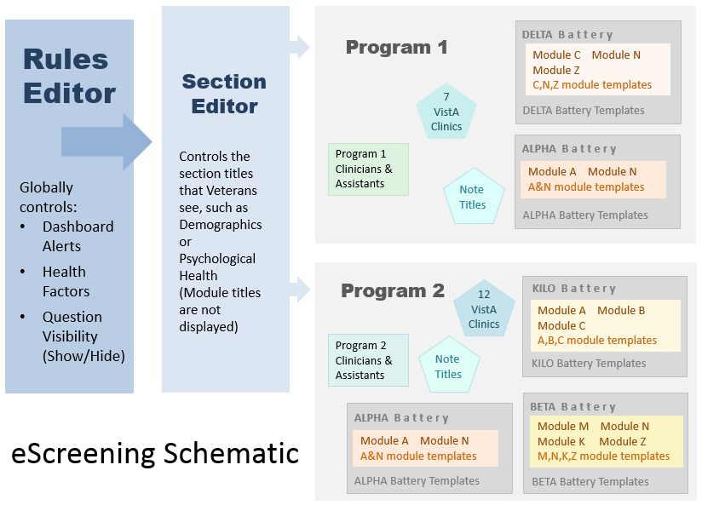
Components

Slide 64
Editing forms and templates Self-Review question
Regarding forms and templates, which, if any, statements are correct?
The forms editors, located on the Editors tab, consist of several editors used to customize MHE to a given clinical workflow.
HSTAs can create assessments from scratch in the Editors tab, or associate assessments with individual Veterans (“creating assessments from the Clinician role”) so that those Veterans may undergo eScreening.
Sections contain groups of similar modules. The purpose of a section is to group and order modules.
Rules allow certain events to be carried out when the rule's expression is found to be true.
All the above statements are correct.

Slide 65
Editing forms and templates Self-Review answer
Regarding editing forms and templates, which, if any, statements are correct?
The forms editors, located on the Editors tab, consist of several editors used to customize MHE to a given clinical workflow.
HSTAs can create assessments from scratch in the Editors tab, or associate assessments with individual Veterans (“creating assessments from the Clinician role”) so that those Veterans may undergo eScreening.
Sections contain groups of similar modules. The purpose of a section is to group and order modules.
Rules allow certain events to be carried out when the rule's expression is found to be true.
All the above statements are correct.

Slide 66
MHE HSTA training
System overview
HSTA tasks and permissions
Managing your users
Customizing MHE for your site
Editing forms and templates
Correcting assessments in an error state
Troubleshooting
Getting help

Slide 67
Correcting assessments in an error state
When an assessment is successfully saved to VistA, the assessment's state is set to Finalized. However, up to five potential errors of transmission can occur during the process. These errors can occur in any combination from one error to all 5. A detailed error message is generated and the assessment’s state is set to “Error”.
Typically, saving an assessment to VistA is a clinician or assistant task, and if the process fails, the HSTA has the system permissions to correct the problem.
Correcting an error assessment consists of locating where the errors are and using the MHE forms editors to fix them by trial and error. Consult the HSTA Administrator Training Manual for strategies to clear the error so that clinicians may proceed.

Slide 68
Correcting assessments in an error state Self-Review question
Correcting an error assessment consists of …
locating where the errors are and using the assessment battery to fix them by trial and error.
consulting the clinicians for strategies to clear the error.
locating where the errors are and using the MHE forms editors to fix them by trial and error.
submitting a requisition for VA IT to reprogram the section.

Slide 69
Correcting assessments in an error state Self-Review answer
Correcting an error assessment consists of …
locating where the errors are and using the assessment battery to fix them by trial and error.
consulting the clinicians for strategies to clear the error.
locating where the errors are and using the MHE forms editors to fix them by trial and error.
submitting a requisition for VA IT to reprogram the section.
Notes:
You can also consult the HSTA Administrator Training Manual for strategies.

Slide 70
MHE HSTA training
System overview
HSTA tasks and permissions
Managing your users
Customizing MHE for your site
Editing forms and templates
Correcting assessments in an error state
Troubleshooting
Getting help

Slide 71
Troubleshooting
As a junior technical administrator, the HSTA performs triage troubleshooting as needed to resolve minor issues. The program administrator assigns trouble tickets to the HSTA to analyze, troubleshoot, and document. If the HSTA can resolve the issue at the configuration or database level, or through coordination with the National Service Desk (in the event of a CPRS or VistA issue), the HSTA should document the resolution within the ticket and mark it resolved.
The HSTA Technical Administrator Manual contains a table of common problem categories with descriptions and actions for reference.

Slide 72
Troubleshooting
If the HSTA is unable to resolve an issue without modification of the application source code, the HSTA should change the ticket state to “Needing Change Control Board review”.
The Change Control Board, which will consist of the VA PM, Program Administrators, HSTAs, and designated VA IT support staff, will prioritize and assign all application change requests to designated application developers.

Slide 73
Troubleshooting Self-Review question
The HSTA performs system triage troubleshooting by …
analyzing and documenting tickets.
consulting the HSTA Tech Admin Manual’s Troubleshooting section.
coordinating with the National Service Desk.
changing a ticket state to “Needing Change Control Board review”.
All of the above.

Slide 74
Troubleshooting Self-Review answer
The HSTA performs system triage troubleshooting by …
analyzing and documenting tickets.
consulting the HSTA Tech Admin Manual’s Troubleshooting section.
coordinating with the National Service Desk.
changing a ticket state to “needing Change Control Board review”.
All of the above.

Slide 75
MHE HSTA training
System overview
HSTA tasks and permissions
Managing your users
Customizing MHE for your site
Editing forms and templates
Correcting assessments in an error state
Troubleshooting
Getting help

Slide 76
Getting help
Refer to the HSTA Administrative Training Manual.
For general troubleshooting, refer to the ATM’s Troubleshooting section, contact your site’s Technical Administrator, or contact:
Liz Floto
858-552-8585 Ext. 5550
Elizabeth.floto@va.gov
Matthew Morgan 858-552-8585 ext.5557
Matthew.Morgan@va.gov

Slide 77
Questions?
?
? ???????? ??????????????????
? ? ? ? ? ? ? ? ? ? ? ? ? ?? ? ? ? ? ??????????????????????????????????????????????????????????????????????????????????? ???? ???? ???? ???? ???????? ???? ???? ????
? ? ? ? ? ? ? ? ? ? ? ? ? ? ? ? ? ? ? ? ? ???????????????????????????? ?????????????????????????????????????? ? ? ? ? ? ? ? ? ? ? ? ? ? ? ? ? ? ? ? ? ? ? ? ? ? ? ?? ? ? ? ? ? ? ? ? ? ? ? ? ? ? ? ? ? ? ? ??? ??? ??? ??? ?????? ??? ??? ??????????????????????????????????????????????????????? ???? ???? ????????? ??? ?????????
??????????????????????????????????

Slide 78
Congratulations!
You have completed
Mental Health eScreening Healthcare System Technical Administrator Training

